Slide 1
Summary
Tianzhu Wei
2017 -12-16

Slide 2
Contents
Cross-layer Betweenness Centrality
Combining Scalability and Efficiency with Opinion-Aware Models
Efficient and Progressive Group Steiner Tree Search
Being prepared in a sparse world :
The case of KNN graph construction
Truss decomposition in massive networks
K-Truss
ApproxmiateClosestCommunitySearchInNetworks

Slide 3
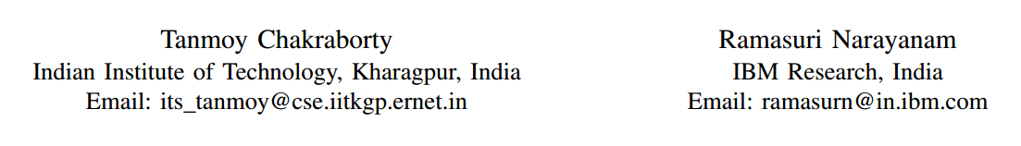
Cross-layer Betweenness Centrality in Multiplex Networks with Applications
ICDE-2016
Notes:
印度克勒格布尔科技大学
IBM印度研究院

Slide 4
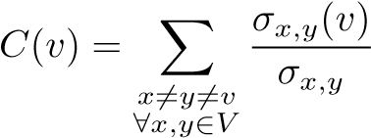
Betweenness centrality
Quantify the relative importance of a vertex
h
f
a
c
g
i
b
d
e
σ _{x,y} (v) is the number of shortest paths between x and y that pass through vertex v
σ _{x,y} is the number of shortest paths between x and y
Notes:
To understand the influential power of the entities

Slide 5
Multiplex networks
Approach 1
h
f
a
c
g
i
b
d
e
h
f
C(a) = C(b) = C(c)
a
c
g
i
b
d
e
Notes:
Different layers in the multiplex network are projected into a single layer to form an aggregated simple network and the metrics are computed over this aggregated network

Slide 6

Multiplex networks
Approach 2
h
f
a
c
g
i
b
d
e
$$+$$
h
f
C(a) = C(b) = C(c)
a
c
g
i
b
d
e
Notes:
: Each layer is treated independently in terms of evaluating the metrics and then these layerwise results are aggregated later in multiple ways

Slide 7
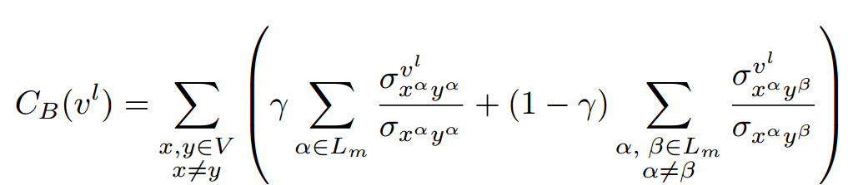
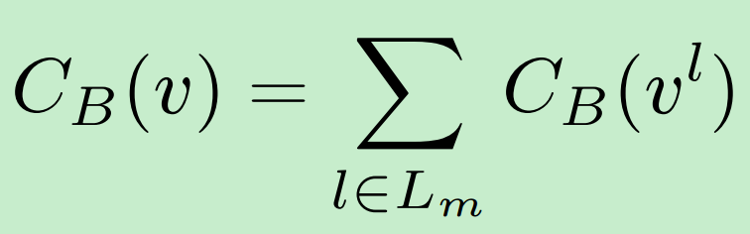
Multiplex networks
a
c
Layer1
b
a
Layer2
c
b
Cross-layer Betweenness Centrality

Slide 8
Application
Community Detection in Multiplex Networks
Finding Interdisciplinary Authors
Initiator Selection for Message Spreading

Slide 9
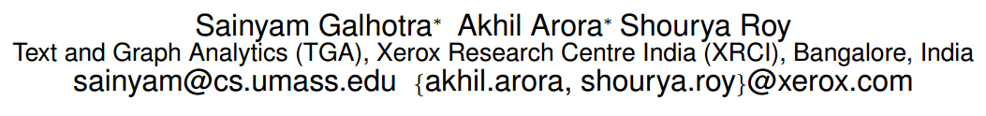
2. Combining Scalability and Efficiency with Opinion-Aware Models.
SIGMOD-2016
Notes:
施乐印度研究中心

Slide 10
Opinion-Aware Models
Linear Threshold ( LT )
Independent Cascade ( IC )
Each node is considered to be contributing fully and positively towards the spread of information
A newly active node is always considered to perceive the information with the same intent as that of the node that activated it
Notes:
作者提出OI模型的目的就是尽量模拟现实生活中传播的过程
用0~1之间的一个数来表示个人意见的强烈程度
O<0 O=0 O>0 分别代表反对 、中立 、支持

Slide 11












Opinion-cum-Interaction Model
OI serves as extension over the IC and LT
O_{B}
$$pBA$$
B
$$pBC$$
O_{A}
$$φBA$$
$$φBC$$
O_{C}
Opinion
$Ov$ $∈[−1,1]$
C
A
$$φAD$$
$$φCD$$
$$pAD$$
D
$$pCD$$
Interaction
O_{D}
negative
neutral
positive
Maximizing the Effective Opinion (MEO)
Notes:
作者最后将评判标准由激活结点的个数转变为了 Opinion 值相加的结果

Slide 12
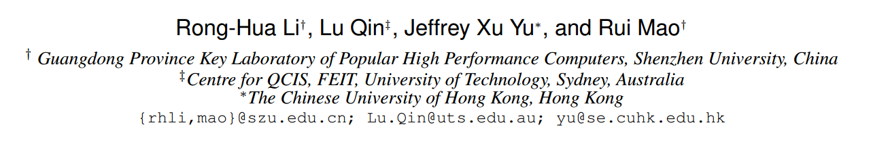
3. Efficient and Progressive Group Steiner Tree Search
SIGMOD-2016
Notes:
深圳大学
悉尼科技大学
香港中文大学

Slide 13
The GST Problem
Group Steiner Tree
1
1
Given a weighted and labelled ( S ) graph G ;
A subset of labels P ( P ⊆ S ) ;
4
4
4
4
4
4
1
1
1
1
Find the minimum weight connected tree from G that includes all the labels in P
v1
v2
v3
v4

Slide 14
Exist Solution
The parameterized DP algorithm
v
T(v,X)
The optimal weight of the state (v , X ) could be obtained by :
u
T(u,X)
a ) Edge growing operation
V
T(v,X)
X
b ) Tree merging operation
X
X = X₁ ∪ X₂
(X₁ ∩ X₂=NULL)
T(v,X₁)
v
v
T(v,X₂)
X₁
X₂
Notes:
state (v , X ) 表示以 v 为根，含有标签集合 X 的树

Slide 15

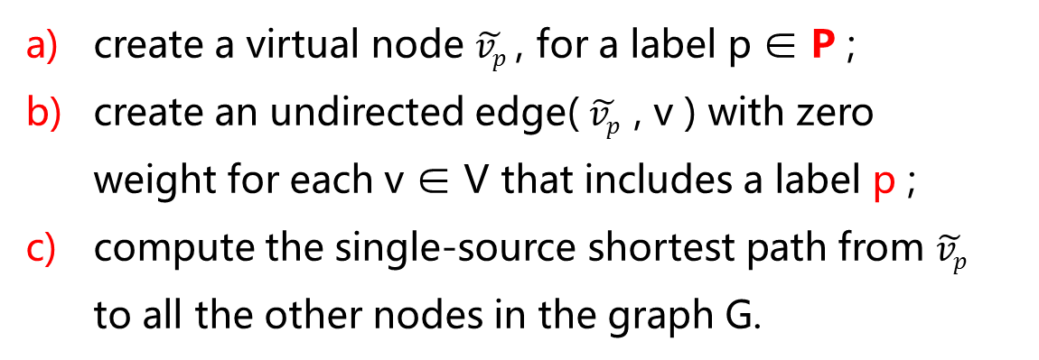

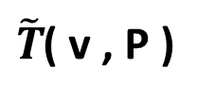

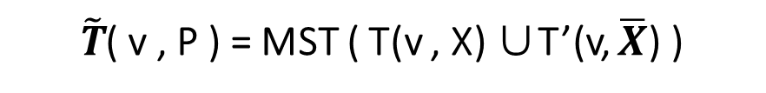

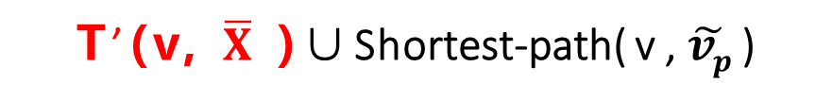


Priority Queue
The Basic algorithm
$\tilde{T}$( v , P )
v1
v2
v3
v4
Preprocessing
a ) Edge growing operation
1
1
create a virtual node $\tilde{vp}$ , for a label p ∈ P ;
create an undirected edge( $\tilde{vp}$ , v ) with zero weight for each v ∈ V that includes a label p ;
compute the single-source shortest path from $\tilde{vp}$ to all the other nodes in the graph G.
b ) Tree merging operation
$$\overline{X}= P\backslash X$$
T(v,X )
T’(v, $\overline{X}$ )
4
4
4
4
4
4
1
1
1
1
$\tilde{T}$( v , P ) = MST ( T(v , X) ∪T’(v, $\overline{X}$) )
T’(v, $\overline{X}$ )∪Shortest-path( v , $\tilde{vp}$ )
v1
v2
v3
v4
$\tilde{vp}$1
$\tilde{vp}$2
$\tilde{vp}$3
$\tilde{vp}$4
Notes:
使用 Dijkstra 方法求解 $\tilde{vp}$ 到其它 V 结点的最短路径
T’ ( v , $\overline{X}$) 将v 到$\overline{X}$ 虚拟结点的最短路径进行合并构成一棵树
然后将 T(v, X)与 T’ ( v , $\overline{X}$) 进行合并形成的最小生成树（MST）
这样获得一个可行解
当我们再进行 边添加 子树合并时就要进行 增长之后的 权重和是否小于 Best的权重，如果大于就舍弃不再进行操作
注意我们会用一个 D 来保存已经求得的状态的最优
注意合并时 X 与X- 不能有交集

Slide 16
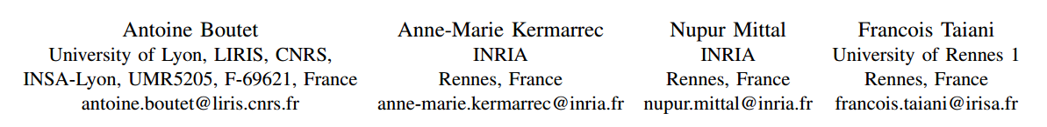
4. Being prepared in a sparse world : The case of KNN graph construction
ICDE-2016
Notes:
Antoine Boutet，法国里昂大学，图像、信息学实验室，国家科学研究中心
Anne-Marie Kermarrec (INRIA)French Institute for Research in Computer Science and Automation法国计算科学与自动化研究所
Nupur Mittal 法国国家信息与自动化研究所
Francois Taiani 雷恩第一大学

Slide 17
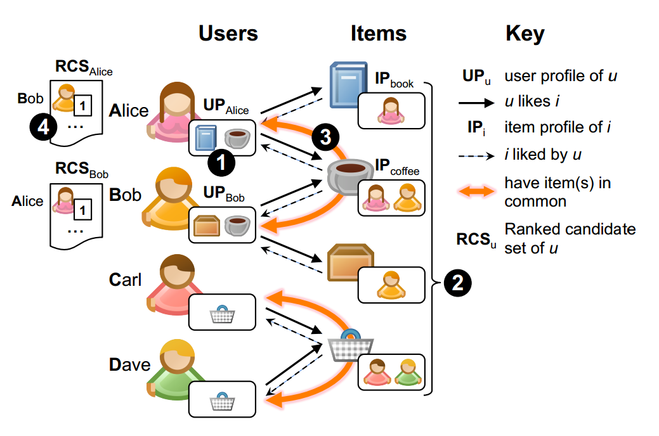
Problem definition
ratings
item1
entity
book
item2
entity
……
coffee
Alice
entity
Our objective is to approximate a KNN graph.
entity
···

Slide 18
KNN graph construction
ratings
f_{sim}( userA , userB )
Cosine
number of common items
Item’s profile
IP_{book} = { Alice }
IP_{coffee} = { Alice , Bob }
······
User’s profile
UP_{Alice} = { book , coffee }
RCS_{Alice} = { ( Bob , 1 ) }
Ordered
Notes:
play a fundamental role in many web-based applications e.g., search ，recommendation and classification

Slide 19
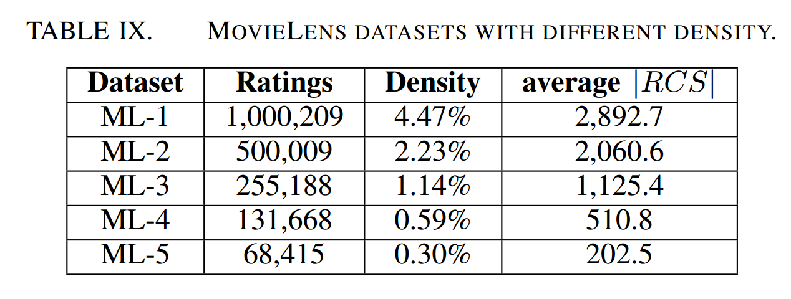
Item’s profile
IP_{book} = { Alice }
IP_{coffee} = { Alice , Bob }
······
User’s profile
UP_{Alice} = { book , coffee }
RCS_{Alice} = { ( Bob , 1 ) }
Ordered

Slide 20

5. Truss decomposition in massive networks
VLDB-2012

Slide 21
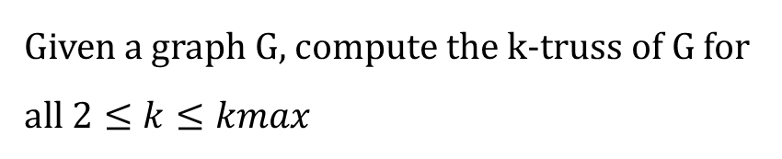
t
Truss decomposition
v2
v5
p1
Given a graph G, compute the k-truss of G for
all $2≤k≤kmax$
P2
q1
v1
v3
q3
q2
v4
P3
An Improved In Memory Algorithm
Bottom-up truss decomposition
Massive Graph
Top-down truss decomposition

Slide 22








Exist Solution
In-Memory Algorithm
a
e
f
j
$$compute support\left(e\right)$$
3
1
2
3
2
2
2
$$support\left(e\left(a,b\right)\right)=| nb\left(a\right)⋂nb\left(b\right) |$$
=3
3
3
4
2
2
3
d
1
g
0
3
3
2
$$nb\left(a\right)=\{e,d,b,c\}$$
1
2
i
b
h
3
0
$$nb\left(b\right)=\{a,e,d,c\}$$
3
1
1
0
1
1
0
$$Remove edge$$
c
L
k
$$remove e :\sup\left(e\right)<(k−2)$$
using a queue
3-Truss
$$k=3$$
$$k=4$$

Slide 23
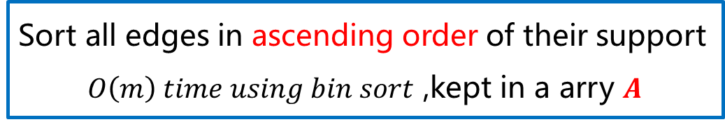

OurSolution
An Improved Algorithm
Comupte the support for edges in G
$$O(m^{1.5})$$
Sort all edges in ascending order of their support
$O\left(m\right) time using bin sort$ ,kept in a arry $Α$
Remove edges
But not explicitly remove

Slide 24











OurSolution
An Improved Algorithm
a
e
f
j
3
1
2
$$remove e :\sup\left(e\right)≤(k−2)$$
k=2
3
2
2
2
3
3
4
2
2
3
d
g
2
$$Φ_{2}=\{(k,i)\}$$
3
3
1
1
2
i
b
h
k-class
$$\deg\left(k\right)=3$$
k=3
$$<$$
$$\deg\left(d\right)=7$$
3
1
3
1
0
$$define as \{e : ∈E_{G} , φ\left(e\right)=k\}$$
1
1
0
$$\operatorname{nb}\left(k\right)=\{d,g,i\}$$
c
L
k
Efficient ?
$$if (d,w)∈E_{G}{ (w∈nb(k))}$$
not explicitly remove
$$\sup\left(d,g\right)←(\sup\left(d,g\right)−1)$$
Reorder
$$\sup\left(k,g\right)←(\sup\left(k,g\right)−1)$$
A
$$(i,k)$$ | $$(d,k)$$ | $$(k,g)$$ | ... | $$(d,g)$$ | ... | $$(a,c)$$ | $$(e,d)$$
$$Φ_{3}=\{(d,k)\}$$
Notes:
K-class 就是指 所指边最大的 trussness

Slide 25


OurSolution
An Improved Algorithm
$$if (d,w)∈E_{G}{ (w∈nb(k))}$$
Reorder
Bin
0 | $$1$$ | $$2$$ | 3 | 4
A
$$\left(i,k\right)0$$ | $$\left(d,k\right)1$$ | $(k,g)$1 | ... | $$\left(d,g\right)2$$ | ... | $(a,c)$3 | $$\left(e,d\right)4$$
Hashtable
$$(i,k)$$ | $$(d,k)$$ | $$(k,g)$$ | ... | $$(d,g)$$ | ... | $$(a,c)$$ | $$(e,d)$$

Slide 26
Bottom-up truss decomposition
Lower-bounding
Top-down truss decomposition
Upper Bounding

Slide 27
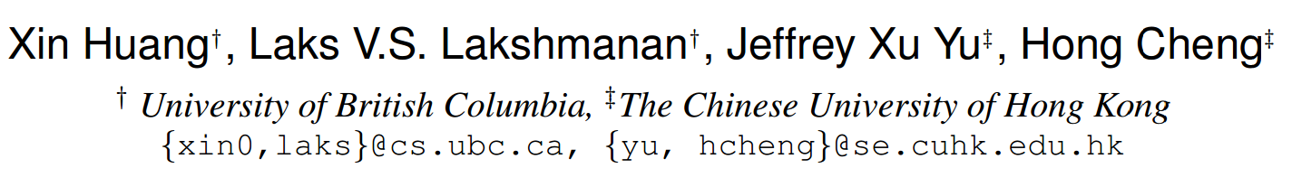
6. Approximate Closest Community Search in Networks
VLDB-2016

Slide 28
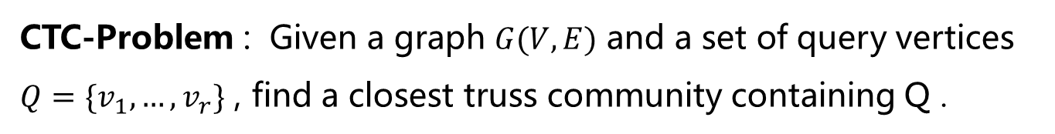
Problem definition
Closest Truss Community
t
Connected k-Truss
v2
v5
p1
2) Smallest Diameter
P2
q1
v1
v3
q3
q2
v4
P3
4-Truss
CTC-Problem : Given a graph $G(V,E)$ and a set of query vertices $Q=\{v_{1},…,v_{r}\}$ , find a closest truss community containing Q .

Slide 29

Our solution
Local Exploration
t
2
2
Form a Steiner Tree T to connect
all query nodes
v2
v5
p1
4
Expand T to get a G0
4
4
P2
Find the higest k containing Q
q1
v1
v3
q3
The smallest trussness of the edge is 2
q2
v4
P3
The smallest trussness of the edge is 4
$$\hat{dist}\left(u,v\right)=dist\left(u,v\right)+γ(\overline{τ}\left(φ\right)−\min_{e∈P}τ(e))$$
$\overline{τ}\left(φ\right)$ is the maxmum trussness of any edge in G
Notes:
$$γ越大表示边的 truss 值起的作用就越大$$

Slide 30


Our solution
t
2
2
Expand T to get a G0
v2
v5
p1
$$k_{t}=\min_{e∈T}τ\left(e\right)=4$$
4
4
4
$$τ\left(e\right)≥k_{t} add to Gt$$
P2
q1
v1
v3
q3
q2
v4
P3
Apply a truss decomposition algorithm on G_{t}
extract the maximal connected k-truss subgraph Ht

Slide 31
改进 LCTC 方法：
生成 Steiner 树 T (假设我们已经找到了一个符合要求的 Steiner 树(同原方法)
将由 1 得到的 T 进行扩展操作得到GT（通过 T 内的结点来进行拓展）添加点构成三角形
t
2
2
v2
v5
p1
4
4
4
P2
q1
v1
v3
q3
q2
v4
P3

Slide 32


作者方法使用索引结构
改进方法使用索引结构
q1
q2
t1
***
v4
v1,v2
v2,v3
u,v
***
vm,vn
…………
…………
$$τ(t1,v2)$$ | $$τ(t1,q1)$$ | $$τ(t1,v1)$$ | $$τ(t1,t2)$$
$$τ(v1)$$ | $$τ(v2)$$ | $$τ(v2)$$ | $$τ(v3)$$
我们的关键字存储的是边
对应的 value 值我们存储的是点，这个可以与边的两个点构成三角形，且是按点的 Truss值由大到小来进行存储的
我们的关键字存储的是顶点
对应的 value 值我们存储的是从这个点出去的边，且是按照边的 Truss 值由大到小进行排列的
平均下来，我们这样做索引结构可能占用更多的内存
设有 V 个结点 E条边
原始索引占用空间：V+2E
新的索引占用空间：2E+tV ( t 为平均每条边的support 值)

Slide 33
Thanks

